Slide 1
ChIP-Seq survival skills
Gene Expression Nanocourse
Gary Hon

Slide 2
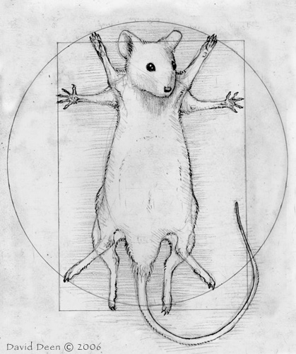
Picture this…
You:
have this awesome hypothesis
spend a few years/weeks to collect specimens
spend a few days to make some ChIP-Seq libraries
send them off for sequencing
get the data back a month later
have a bioinformatician … on vacation
need results, now

Slide 3
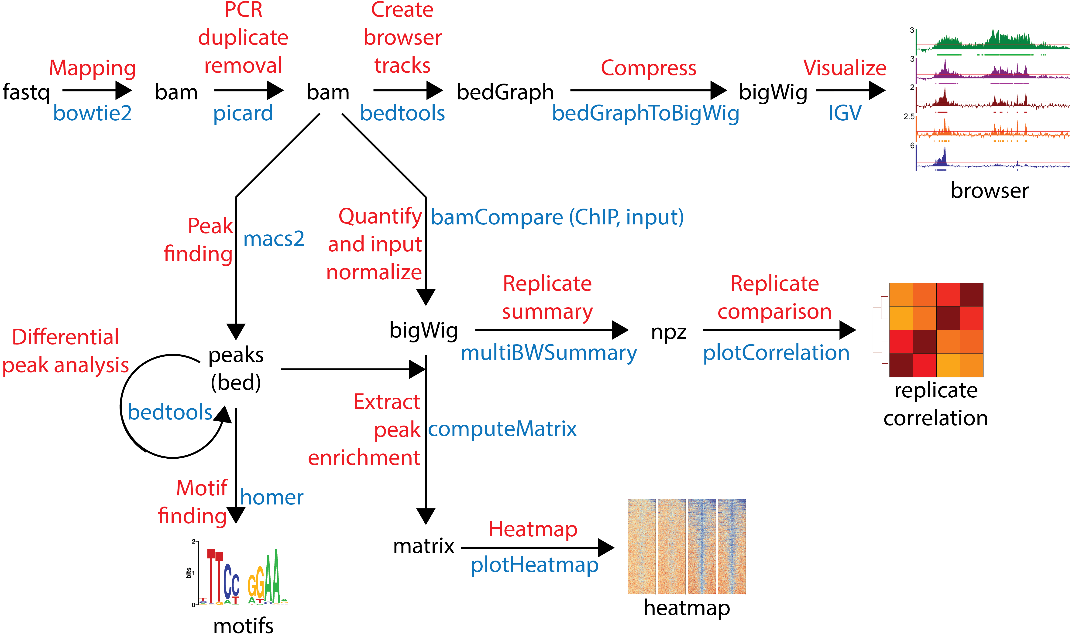
By the end of this class, you will be able to…
Process raw ChIP-Seq data
Visualize data
Find peaks
Find motifs
Make heatmaps
Perform differential analysis

Slide 4
Today’s overview
AM (9-12pm)
ChIP-Seq experiment
Data (+ QC)
Mapping (+QC)
Duplicate removal (+QC)
Visualization (+QC)
Peak finding
PM (1-5pm)
Quantification
Heatmaps
Meta plots
Differential analysis
Motif finding

Slide 5
What you’ll accomplish today

Slide 6
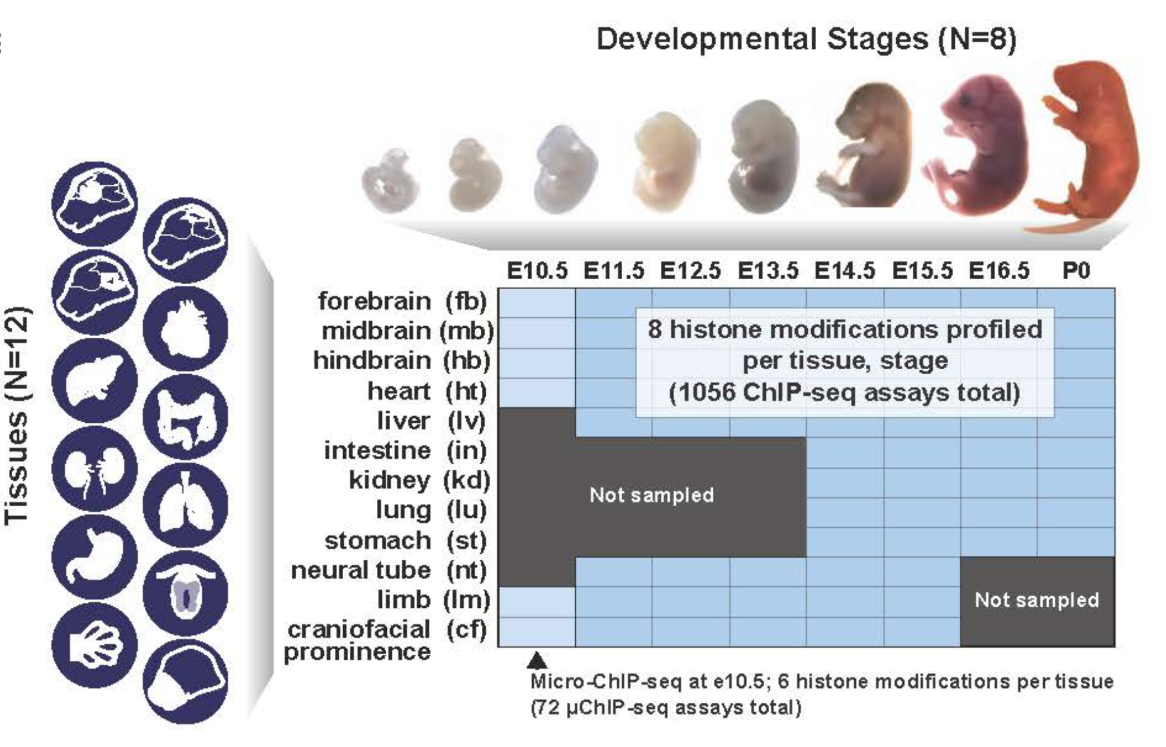
Case study: Heart development
ENCODE Project
https://www.biorxiv.org/content/early/2017/07/21/166652
Heart: e11.5 vs P0
H3K27ac and input
2 biological replicates

Slide 7
Case study: Questions we’ll answer
Did the experiment work (technically)?
Does it map?
Is there ChIP enrichment?
Do the biological replicates agree?
How do H3K27ac peaks change during heart development?
Are more peaks gained or lost?
Which transcription factors drive development?

Slide 8
Bioinformatics: steep learning curve
Ability
Time

Slide 9
Tips
It will be frustrating – keep trying!
Ask questions!
Work with a partner.
Does it work? Try it!
Tell us how we can improve.

Slide 10
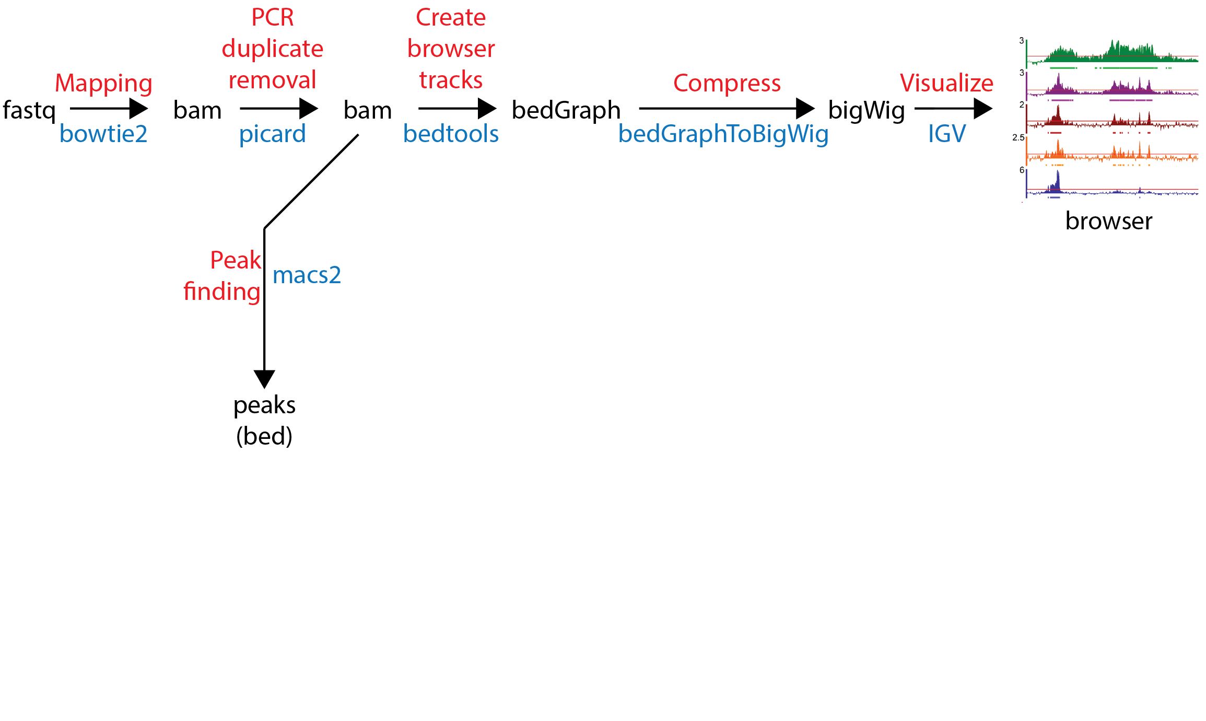
Overview: Morning

Slide 11
ChIP-Seq experiment
DNA ➔ fastq

Slide 13
Mapping
Fastq ➔ BAM

Slide 14
Setup
mkdir part1
cd part1
cp ../../shared/class2/part1/* .

Slide 15
The command: bowtie2
Load the programs bowtie2 and samtools
module load bowtie2
module load samtools
# make a directory to hold your raw alignments
mkdir bam_files
# mapping
bowtie2 -p 32\
-x [INDEX]\
-U [FASTQ FILE] \
| samtools view -q10 -bS -o - -\
| samtools sort -o [OUTPUT FILE] -
Make a new folder
Call bowtie with 32 processors
Convert output to BAM

Slide 16
The command: bowtie2
module load bowtie2
module load samtools
# make a directory to hold your raw alignments
mkdir bam_files
# mapping
bowtie2 -p 32\
-x /project/apps_database/iGenomes/Mus_musculus/UCSC/mm10/Sequence/Bowtie2Index/genome\
-U /archive/nanocourse/June2018/shared/fastq.chr19/ChIP-Seq/heart.e11.5.rep1.ChIP-Seq.H3K27ac.fastq.gz\
| samtools view -q10 -bS -o - -\
| samtools sort -o bam_files/heart.e11.5.rep1.ChIP-Seq.H3K27ac.bam -

Slide 17
Open script1
Applications -> Accessories -> gedit Text Editor
File -> Open
File System -> archive -> nanocourse -> June2018 -> trainXY -> part1 -> script1_mapping.sh

Slide 18
You try mapping (script1)
Example: H3K27ac
You do: input

Slide 19
Examining the output
How many reads map to chr19?

Slide 20
PCR duplicate removal
BAM ➔ nodup BAM

Slide 21
What is PCR duplicate removal?
ChIP-Seq uses PCR
Some fragments amplify better than others
Remove bias: if 2+ reads map to same place, then keep 1

Slide 22
The command: picard
Load the programs java, picard and samtools
module load java
module load picard/2.10.3
module load samtools
# remove PCR duplicates
java -jar $PICARD_DIR/picard.jar MarkDuplicates \
INPUT=[INPUT]\
OUTPUT=[OUTPUT]\
METRICS_FILE=metrics.txt\
REMOVE_DUPLICATES=true\
ASSUME_SORTED=true\
TMP_DIR=temp
# index the final BAM file
samtools index [OUTPUT]
Call picard to remove duplicates.
Index the BAM file

Slide 23
The command: picard
module load java
module load picard/2.10.3
module load samtools
# remove PCR duplicates
java -jar $PICARD_DIR/picard.jar MarkDuplicates \
INPUT=bam_files/heart.e11.5.rep1.ChIP-Seq.H3K27ac.bam\
OUTPUT=bam_files/heart.e11.5.rep1.ChIP-Seq.H3K27ac.nodup.bam\
METRICS_FILE=metrics.txt\
REMOVE_DUPLICATES=true\
ASSUME_SORTED=true\
TMP_DIR=temp
# index the final BAM file
samtools index bam_files/heart.e11.5.rep1.ChIP-Seq.H3K27ac.nodup.bam

Slide 24
You try removing duplicates (script2)
Example: H3K27ac
You do: input

Slide 25
Examining the output
How many reads map to chr19?
How many reads map to region:
chr19: 10,000,000 – 11,000,000?
Compare with before PCR duplicate removal

Slide 26
Visualization
Nodup BAM ➔ bedGraph ➔ bigWig

Slide 27
The command: visualization
Load the programs UCSC tools and bedtools
module load UCSC_userApps/v317
module load bedtools
# make a directory to hold your genome browser files
mkdir browser_files
# get genome browser track
bedtools genomecov -ibam\
[INPUT BAM FILE]\
-bga\
> [OUTPUT BEDGRAPH FILE]
# compress genome browser track
bedSort [OUTPUT BEDGRAPH FILE] \
[OUTPUT BEDGRAPH FILE]
fetchChromSizes mm10 > mm10.chrom.sizes
bedGraphToBigWig [OUTPUT BEDGRAPH FILE] \
mm10.chrom.sizes\
[OUTPUT BIGWIG FILE]
Make a BedGraph file
Sort BedGraph file before compress
Get mouse chr size
Compress BedGraph file

Slide 28
The command: visualization
module load UCSC_userApps/v317
module load bedtools
# make a directory to hold your genome browser files
mkdir browser_files
# get genome browser track
bedtools genomecov -ibam\
bam_files/heart.e11.5.rep1.ChIP-Seq.H3K27ac.nodup.bam\
-bga\
> browser_files/heart.e11.5.rep1.ChIP-Seq.H3K27ac.bedGraph
# compress genome browser track
bedSort browser_files/heart.e11.5.rep1.ChIP-Seq.H3K27ac.bedGraph\
browser_files/heart.e11.5.rep1.ChIP-Seq.H3K27ac.bedGraph
fetchChromSizes mm10 > mm10.chrom.sizes
bedGraphToBigWig browser_files/heart.e11.5.rep1.ChIP-Seq.H3K27ac.bedGraph\
mm10.chrom.sizes\
browser_files/heart.e11.5.rep1.ChIP-Seq.H3K27ac.bw

Slide 29
You try creating browser files (script3)
Example: H3K27ac
You do: input

Slide 30
Examining the output
What does a bedGraph file look like?
Compare the size of a bedGraph file and a bigwig file

Slide 31
Let’s see the data
Use Integrated Genome Viewer
module load IGV
igv.sh
(1. load mm10)
(2. load BigWig files: /archive/nanocourse/June2018/trainXY/part1/browser_files)
(3. go to chr19)

Slide 32
Case study: Questions we’ll answer
Did the experiment work (technically)?
Does it map?
Is there ChIP enrichment?
Do the biological replicates agree?
How do H3K27ac peaks change during heart development?
Are more peaks gained or lost?
Which transcription factors drive development?
v

Slide 33
Peak finding
Nodup BAM ➔ peaks (bed)

Slide 34
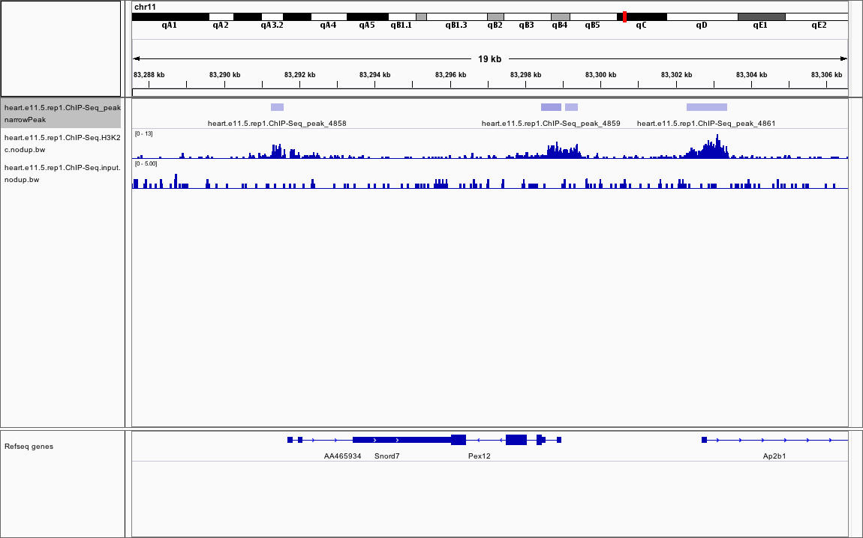
What’s a ChIP-Seq peak?
Enrichment of ChIP signal over input signal
peak
ChIP
input

Slide 35
The command: peak finding
Load the program macs.
module load macs
# make a new directory for peaks
mkdir peaks
# call peaks
macs2 callpeak -t [TREATMENT BAM FILE]\
-c [CONTROL BAM FILE]\
-f BAM\
-g mm\
--outdir peaks\
-n [NAME OF RUN]
Call ChIP-Seq peaks.
mm = mouse

Slide 36
The command: peak finding
module load macs
# make a new directory for peaks
mkdir peaks
# call peaks
macs2 callpeak -t bam_files/heart.e11.5.rep1.ChIP-Seq.H3K27ac.nodup.bam\
-c bam_files/heart.e11.5.rep1.ChIP-Seq.input.nodup.bam\
-f BAM\
-g mm\
--outdir peaks\
-n heart.e11.5.rep1.ChIP-Seq

Slide 37
You try calling peaks (script4)
Example: H3K27ac

Slide 38
Examining the output
narrowPeak vs summit

Slide 39
Examining the output
narrowPeak
Chr start end name score strand signal pval qval peak
chr1 3120366 3120936 name_1 86 . 5.79747 10.8519 8.64752 455
chr1 4427112 4427307 name_2 36 . 3.86498 5.64030 3.67179 104
chr1 4491729 4492010 name_3 43 . 3.96239 6.30988 4.31582 232
chr1 4492246 4493684 name_4 134 . 7.40788 15.8530 13.4946 1195
chr1 4494431 4494661 name_5 44 . 4.18706 6.43675 4.42406 57
chr1 4495649 4495910 name_6 58 . 4.52844 7.89264 5.81651 114
chr1 4495998 4496399 name_7 55 . 3.95847 7.62939 5.56343 159
chr1 4496464 4498153 name_8 364 . 13.1959 39.2158 36.4125 693
chr1 4543964 4544329 name_9 79 . 5.39833 10.1365 7.96145 182
chr1 4544635 4544829 name_10 22 . 3.11331 4.16014 2.29512 120

Slide 40
Visualize peaks
Load the narrowPeak file onto IGV.
Verify that peaks make sense.

Slide 41
Mission accomplished: Morning

Slide 42
Lunch

Slide 43
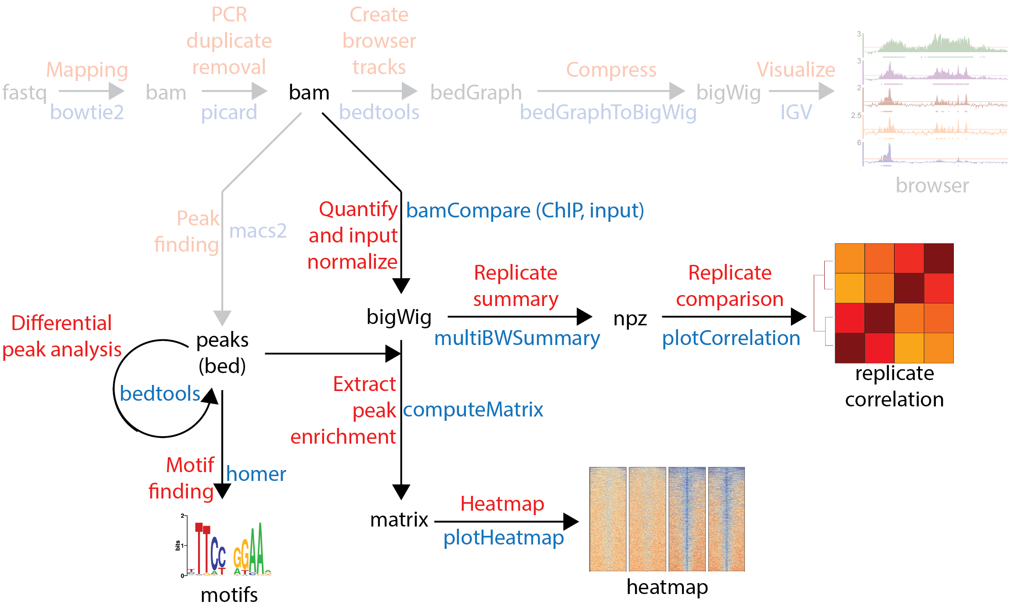
Overview: Afternoon

Slide 44
Quantification
BAM ➔ log2 (ChIP / input)

Slide 45
How do you quantify ChIP-Seq enrichment?
peak
ChIP
input
ChIP enrichment = log₂ (ChIP signal / input signal)
= log₂ (ChIP RPKM / input RPKM)
RPKM = # reads per kilobase of genome per million reads sequenced

Slide 46
The command: bamCompare
Load the program deeptools.
module load deeptools/2.5.0.1
mkdir bw_log2ratio
bamCompare --normalizeUsingRPKM\
-b1 [CHIP FILE]\
-b2 [INPUT FILE]\
-o [OUTPUT FILE]
Normalize ChIP and input.

Slide 47
The command: bamCompare
module load deeptools/2.5.0.1
mkdir bw_log2ratio
bamCompare --normalizeUsingRPKM\
-b1 bam_files/heart.e11.5.rep1.ChIP-Seq.H3K27ac.nodup.bam\
-b2 bam_files/heart.e11.5.rep1.ChIP-Seq.input.nodup.bam\
-o bw_log2ratio/heart.e11.5.rep1.ChIP-Seq.H3K27ac.log2ratio.bw

Slide 48
You try normalization (script5)
Example: H3K27ac

Slide 49
Visualize the normalized data
Load the normalized bigWig file onto IGV.
Verify that enrichment makes sense.

Slide 50
Heatmap of peaks
peaks + bigWig ➔ matrix ➔ heatmap

Slide 51
What is a heatmap?
track
heatmap
Region 1
Region 2
Heatmap of multiple regions
Region 1
Region 2
Need: A list of regions (peaks) and tracks to extract heatmaps

Slide 52
The command: computeMatrix and plotHeatmap
Load the program deeptools.
module load deeptools/2.5.0.1
mkdir matrix
computeMatrix reference-point
-S [INPUT BIGWIG FILE]\
-R [INPUT PEAKS SUMMITS FILE]\
-a 3000\
-b 3000\
-out [OUTPUT MATRIX]
plotHeatmap --matrixFile [OUTPUT MATRIX]\
--outFileName [OUTPUT HEATMAP]
Create a matrix of heatmap values with window -3kb to 3kb.
Use matrix to make a heatmap image.

Slide 53
The command: bamCompare
module load deeptools/2.5.0.1
mkdir matrix
computeMatrix reference-point
-S bw_log2ratio/heart.e11.5.rep1.ChIP-Seq.H3K27ac.log2ratio.bw\
-R peaks/heart.e11.5.rep1.ChIP-Seq_summits.bed\
-a 3000\
-b 3000\
-out matrix/heart.e11.5.rep1.ChIP-Seq.peaks.H3K27ac.log2ratio.matrix
plotHeatmap --matrixFile matrix/heart.e11.5.rep1.ChIP-Seq.peaks.H3K27ac.log2ratio.matrix\
--outFileName matrix/heart.e11.5.rep1.ChIP-Seq.peaks.H3K27ac.log2ratio.matrix.png

Slide 54
You try making a heatmap (script6)
Example: H3K27ac on chr19

Slide 55
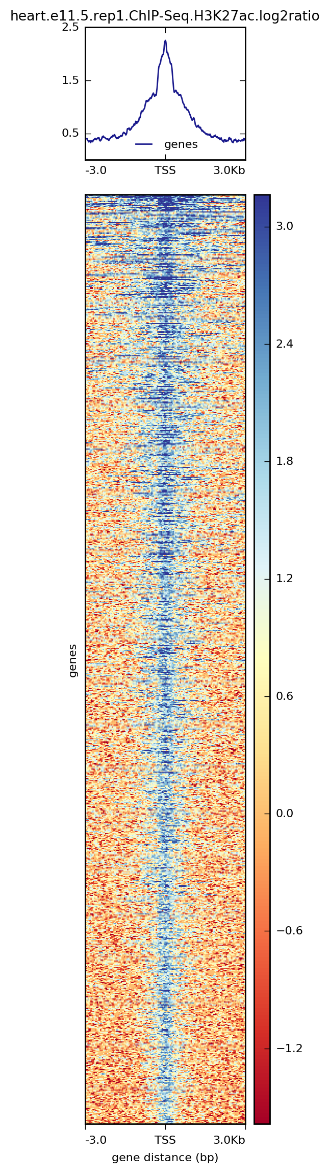
Examining the output
See your heatmap (using the eog command)
Verify that enrichment makes sense.

Slide 56
At this point
You analyzed 1 ChIP-Seq experiment on chr19.
Let’s use more data on the full genome for more interesting analysis.
2 cells: e11.5 and p0
2 libraries per cell: H3K27ac and input
2 replicates per library: rep1 and rep2
Setup:
cd ..
mkdir part2
cd part2
cp ../../shared/class2/part2/* .

Slide 57
Compare replicates
Many bigWigs ➔ npz ➔ plot

Slide 58
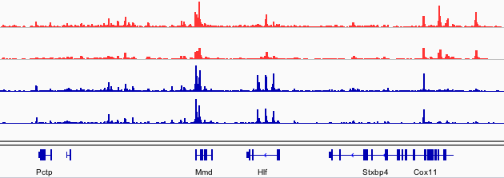
How to QC multiple samples?
Key idea:
Libraries from biological replicates are more similar
Libraries from different conditions are less similar
E11.5, rep1
E11.5, rep2
p0, rep1
p0, rep2

Slide 59
The command: multiBWSummary and plotCorrelation
Load the program deeptools.
module load deeptools/2.5.0.1
cp -rp ../../shared/processed/ChIP-Seq/bw_log2ratio .
multiBigwigSummary bins -b [BW FILES]\
-o [OUTPUT NPZ]
plotCorrelation -in [OUTPUT NPZ]\
--corMethod pearson\
--whatToPlot heatmap\
-o [HEATMAP OUTPUT]
plotCorrelation -in [OUTPUT NPZ]\
--corMethod pearson\
--whatToPlot scatterplot\
-o [SCATTERPLOT OUTPUT]
Copy bw files.
Summarize.
Plot correlation and scatterplot comparisons.

Slide 60
The command: multiBWSummary and plotCorrelation
module load deeptools/2.5.0.1
cp -rp ../../shared/processed/ChIP-Seq/bw_log2ratio .
multiBigwigSummary bins -b bw_log2ratio/*bw\
-o all_samples.H3K27ac.npz
plotCorrelation -in all_samples.H3K27ac.npz\
--corMethod pearson\
--whatToPlot heatmap\
-o all_samples.H3K27ac.heatmap.png
plotCorrelation -in all_samples.H3K27ac.npz\
--corMethod pearson\
--whatToPlot scatterplot\
-o all_samples.H3K27ac.scatterplot.png

Slide 61
You try plotting correlation (script7)

Slide 62
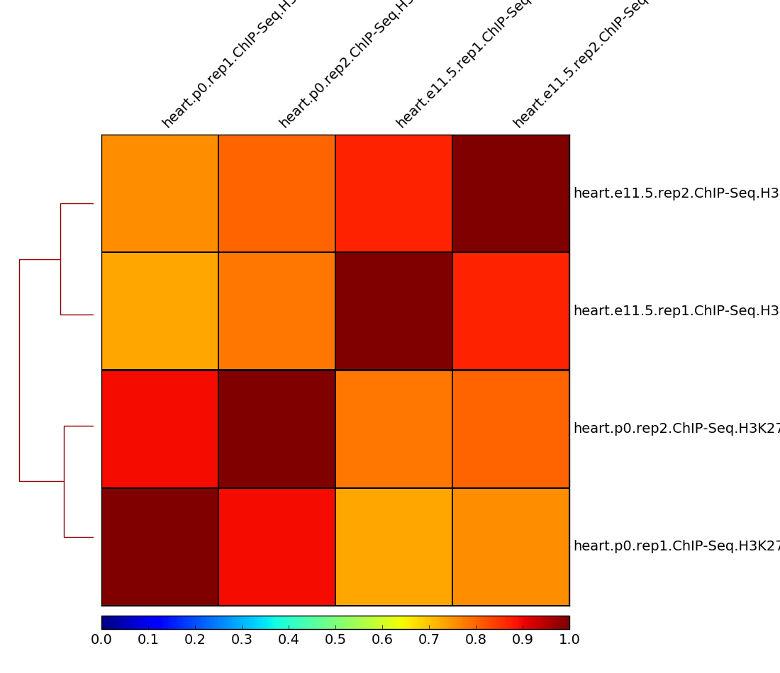
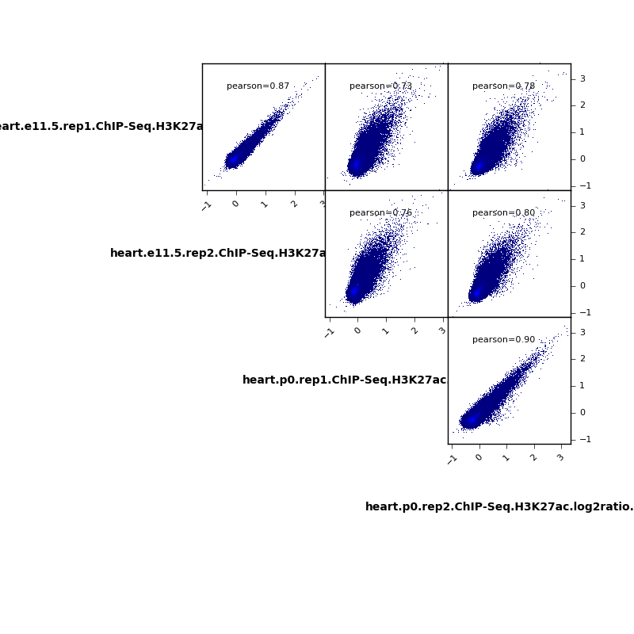
Examining the output
Do the replicates correlate?
Verify that enrichment makes sense.

Slide 63
Case study: Questions we’ll answer
Did the experiment work (technically)?
Does it map?
Is there ChIP enrichment?
Do the biological replicates agree?
How do H3K27ac peaks change during heart development?
Are more peaks gained or lost?
Which transcription factors drive development?
v

Slide 64
Differential peak analysis
Peaks ➔ peaks

Slide 65
Find confident peaks
Key idea:
Confident peaks: peaks shared between replicates
Replicate 1
Replicate 2

Slide 66
The command: bedtools
Load bedtools.
module load bedtools
cp -rp ../../shared/processed/ChIP-Seq/peaks .
# get replicate common
bedtools window -w 2000\
-u\
-a [PEAKS1 INPUT BED]\
-b [PEAKS2 INPUT BED]\
> [OUTPUT PEAKS BED]
Copy peaks.
e11.5 peaks.

Slide 67
The command: bedtools
module load bedtools
cp -rp ../../shared/processed/ChIP-Seq/peaks .
# get replicate common
bedtools window -w 2000\
-u\
-a peaks/heart.e11.5.rep1.ChIP-Seq_summits.bed\
-b peaks/heart.e11.5.rep2.ChIP-Seq_summits.bed\
> peaks/heart.e11.5.common.ChIP-Seq_summits.bed

Slide 68
You try processing peaks (script8)
Example: e11.5
You do: p0

Slide 69
Examining the output
How many peaks are there in each replicate?
How many peaks are common between replicates?

Slide 70
Find biologically interesting peaks
Unique to e11.5 heart
Unique to p0 heart
e11.5
p0

Slide 71
The command: bedtools
Load bedtools.
module load bedtools
# get early unique
bedtools window -w 2000\
-v\
-a [INPUT PEAKS]\
-b [INPUT PEAKS TO REMOVE]\
> [OUTPUT PEAKS]
Get e11.5-unique.

Slide 72
The command: bedtools
module load bedtools
# get early unique
bedtools window -w 2000\
-v\
-a peaks/heart.e11.5.common.ChIP-Seq_summits.bed\
-b peaks/heart.p0.common.ChIP-Seq_summits.bed\
> peaks/heart.early_unique.ChIP-Seq_summits.bed

Slide 73
You try processing peaks (script8)
Example: e11.5-unique
You do: p0-unique

Slide 74
Examining the output
How many peaks are unique to e11.5?
How many peaks are unique to p0?

Slide 75
Case study: Questions we’ll answer
Did the experiment work (technically)?
Does it map?
Is there ChIP enrichment?
Do the biological replicates agree?
How do H3K27ac peaks change during heart development?
Are more peaks gained or lost?
Which transcription factors drive development?

Slide 76
Heatmaps of peaks
peaks + bigWig ➔ matrix ➔ heatmap

Slide 77
Side-by-side heatmaps
Track A
heatmap
Track B
heatmap
Region 1
Region 2
Heatmap of multiple regions
Track A
Track B
Region 1
Region 2

Slide 78
The command: computeMatrix and plotHeatmap
Load the program deeptools.
module load deeptools/2.5.0.1
mkdir matrix
computeMatrix reference-point
-S [INPUT BIGWIG FILE1]\
[INPUT BIGWIG FILE2]\
[INPUT BIGWIG FILE3]\
[INPUT BIGWIG FILE4]\
-R [INPUT PEAKS SUMMITS FILE]\
-a 3000\
-b 3000\
-p max\
-out [OUTPUT MATRIX]
plotHeatmap --matrixFile [OUTPUT MATRIX]\
--outFileName [OUTPUT HEATMAP]
Create a matrix of heatmap values with window -3kb to 3kb.
Use matrix to make a heatmap image.

Slide 79
The command: computeMatrix and plotHeatmap
module load deeptools/2.5.0.1
mkdir matrix
computeMatrix reference-point
-S bw_log2ratio/heart.e11.5.rep1.ChIP-Seq.H3K27ac.log2ratio.bw\
bw_log2ratio/heart.e11.5.rep2.ChIP-Seq.H3K27ac.log2ratio.bw\
bw_log2ratio/heart.p0.rep1.ChIP-Seq.H3K27ac.log2ratio.bw\
bw_log2ratio/heart.p0.rep2.ChIP-Seq.H3K27ac.log2ratio.bw\
-R peaks/heart.early_unique.ChIP-Seq_summits.bed\
-a 3000\
-b 3000\
-p max\
-out matrix/all_samples.peaks_early_unique.H3K27ac.log2ratio.matrix
plotHeatmap --matrixFile matrix/all_samples.peaks_early_unique.H3K27ac.log2ratio.matrix\
--outFileName matrix/all_samples.peaks_early_unique.H3K27ac.log2ratio.matrix.png

Slide 80
You try making a multi heatmap (script9)
Example: e11.5-unique
You try: p0-unique

Slide 81
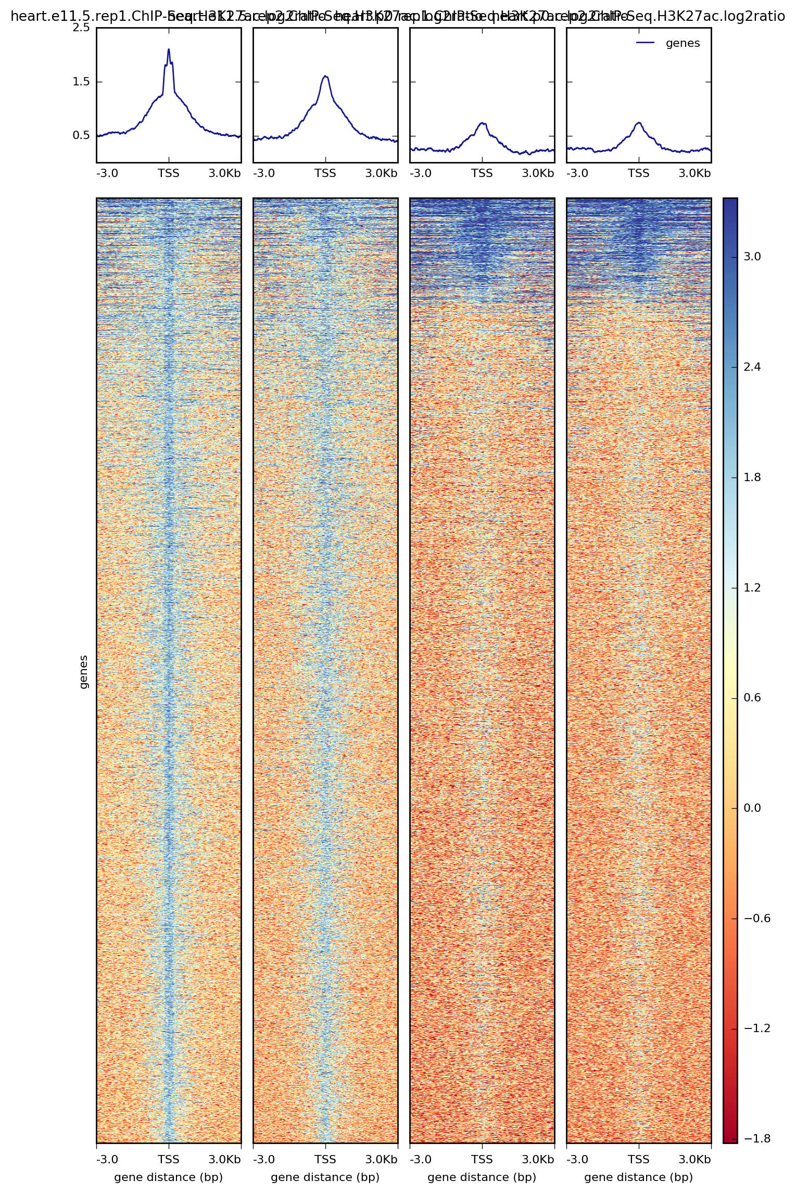
Examining the output
See your heatmap
Verify that enrichment makes sense.

Slide 82
Finding motifs
peaks ➔ motifs

Slide 83
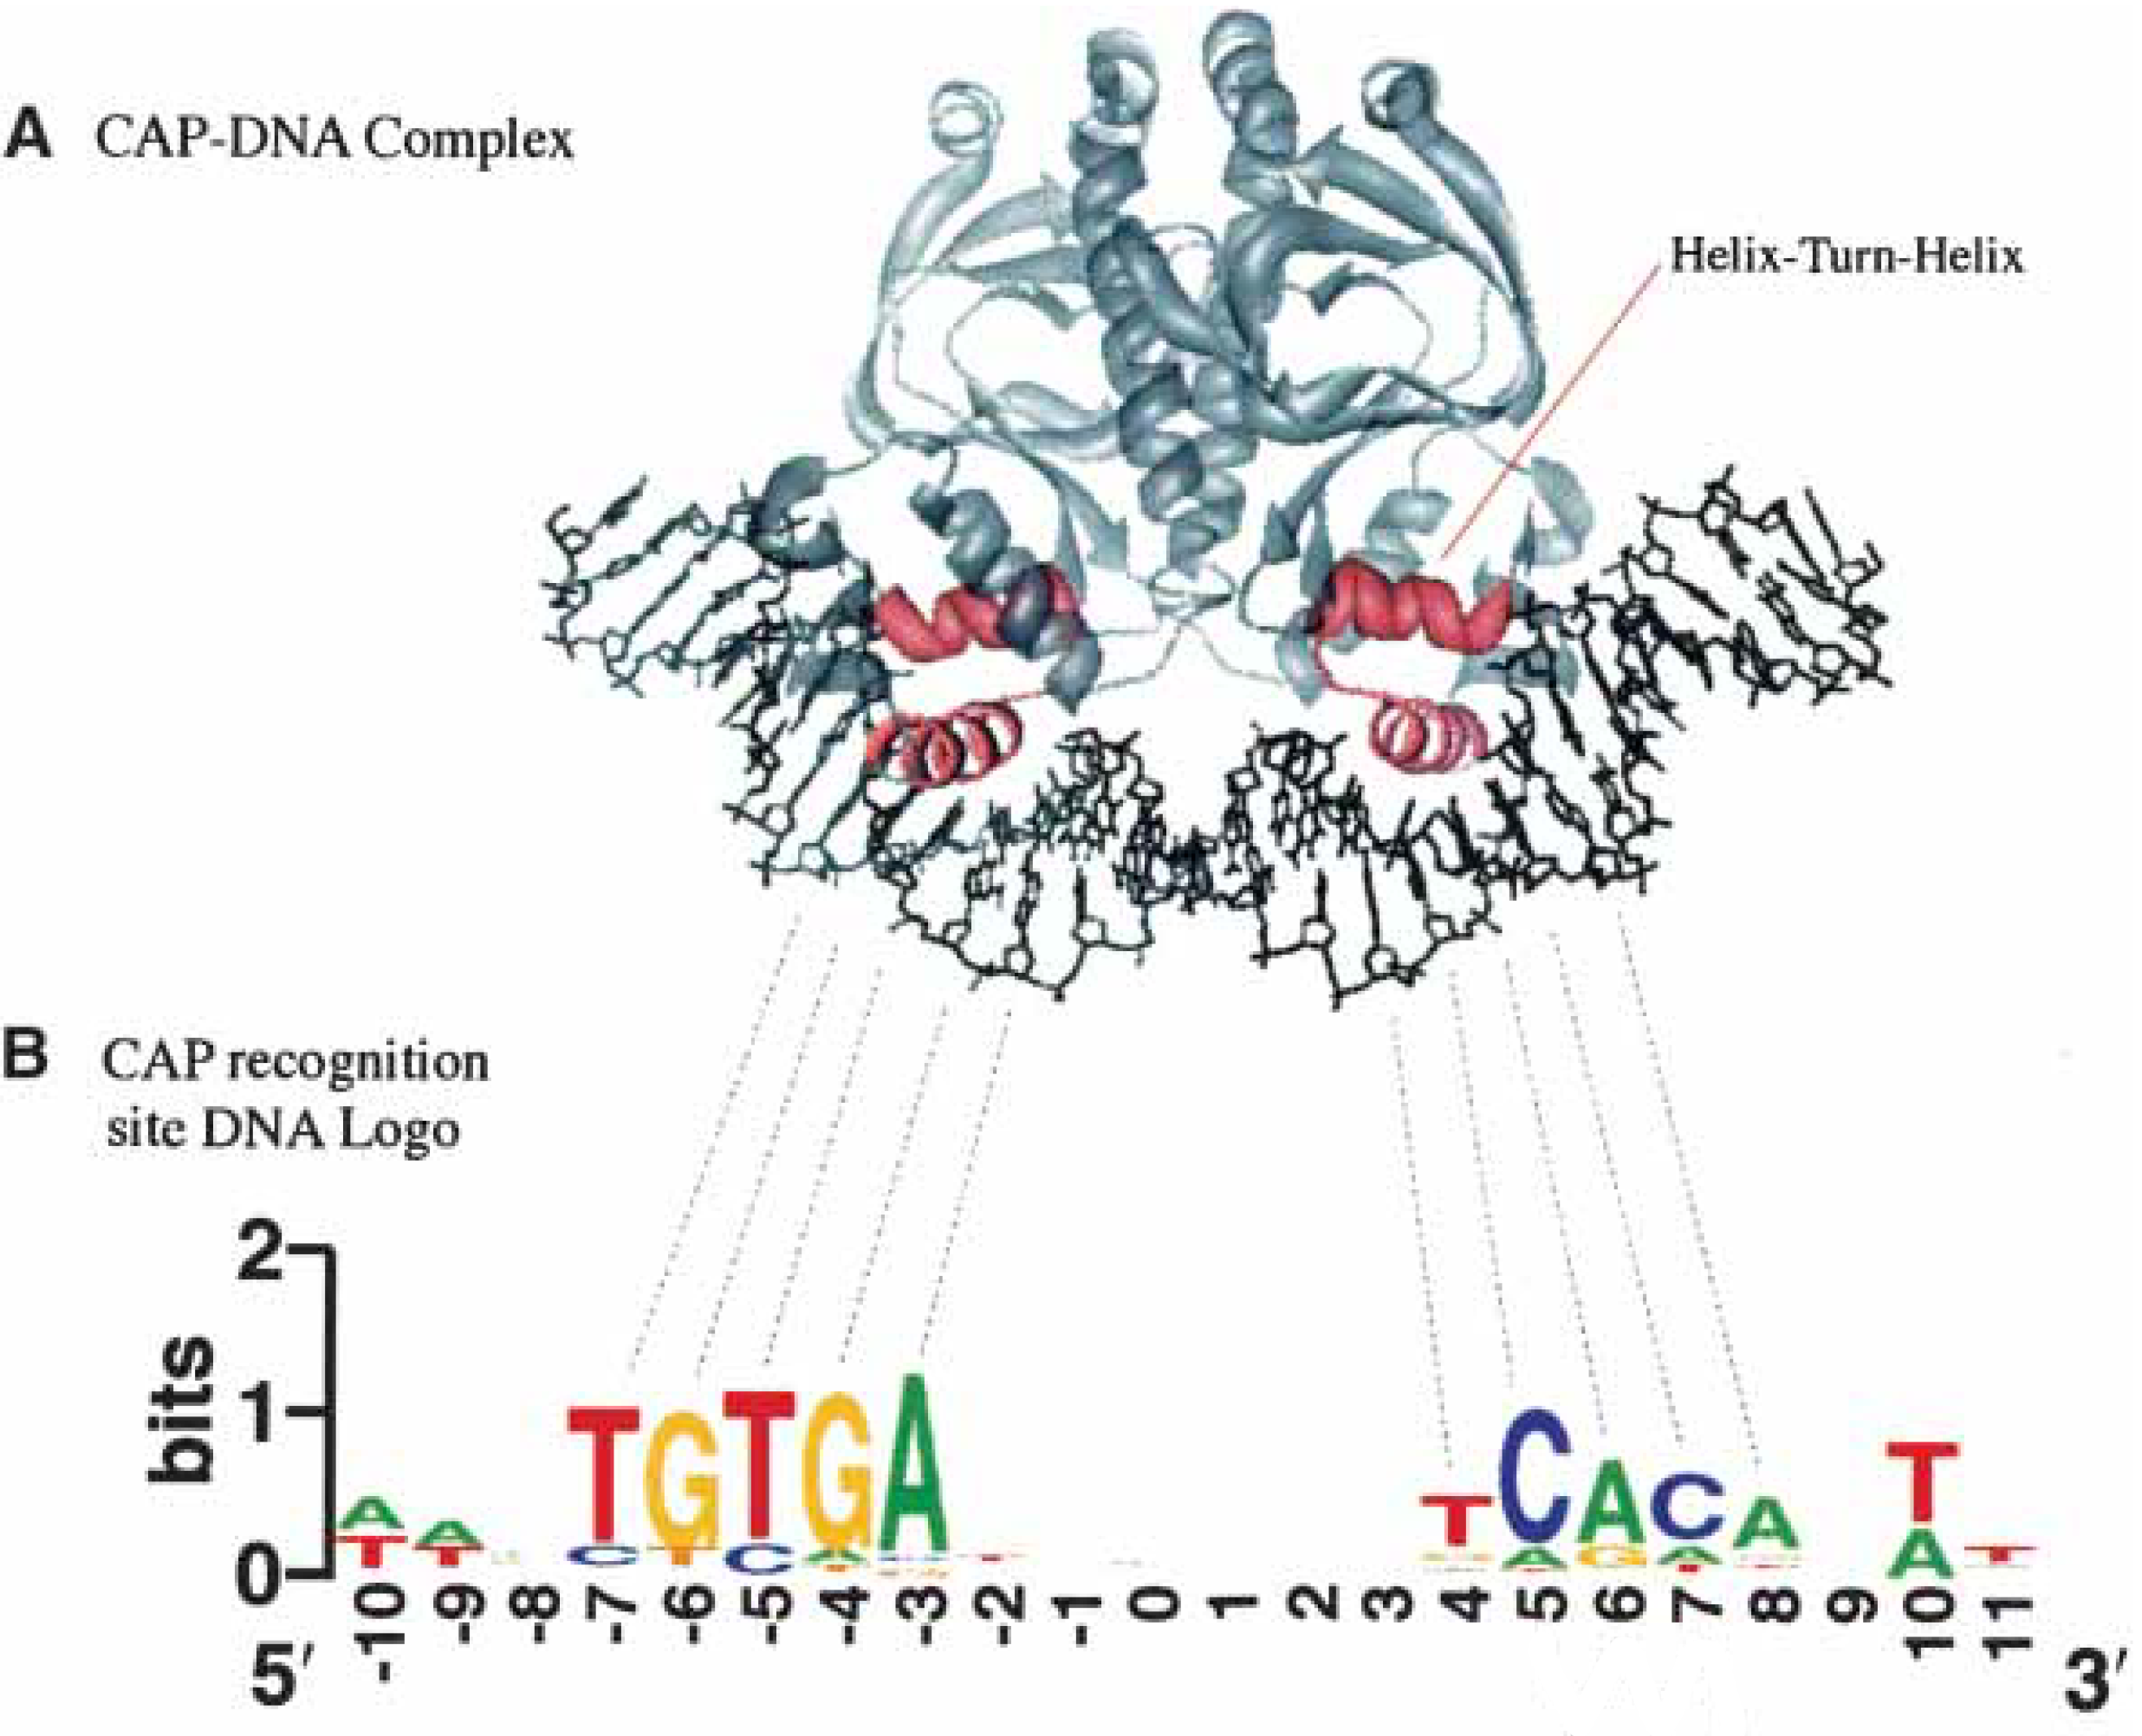
What’s a sequence motif?

Slide 84
The command: homer
Load the program deeptools.
module load homer
mkdir motifs
findMotifsGenome.pl [INPUT PEAKS (BED) FOREGROUND]\
mm10\
[OUTPUT FOLDER]\
-size 500\
-p 32\
-bg [INPUT PEAKS (BED) BACKGROUND]\
-nomotif
Find known motifs.

Slide 85
The command: homer
module load homer
mkdir motifs
findMotifsGenome.pl peaks/heart.early_unique.ChIP-Seq_summits.bed\
mm10\
motifs/heart.early_unique\
-size 500\
-p 32\
-bg peaks/heart.late_unique.ChIP-Seq_summits.bed\
-nomotif

Slide 86
You try finding motifs (script10)
Example: e11.5-unique
You try: p0-unique

Slide 87
Examining the output
Verify that the motifs makes sense.

Slide 88
Case study: Questions we’ll answer
Did the experiment work (technically)?
Does it map?
Is there ChIP enrichment?
Do the biological replicates agree?
How do H3K27ac peaks change during heart development?
Are more peaks gained or lost?
Which transcription factors drive development?

Slide 89
Mission accomplished: Today

Slide 90
Bioinformatics: steep learning curve
Ability
Time

Slide 91
Tips
It will be frustrating – keep trying!
Ask questions!
Work with a partner!
Does it work? Try it!
Tell us how we can improve.

Slide 92

!!!
ANALYZE

